Slide 1
Ch. 8: Confidence Interval Estimation
In chapter 6, we had information about the population and, using the theory of Sampling Distribution (chapter 7), we learned about the properties of samples. (what are they?)
Sampling Distribution also give us the foundation that allows us to take a sample and use it to estimate a population parameter. (a reversed process)

Slide 2
A point estimate is a single number,
  How much uncertainty is associated with a point estimate of a population parameter?
An interval estimate provides more information about a population characteristic than does a point estimate. It provides a confidence level for the estimate. Such interval estimates are called confidence intervals
Upper
Confidence
Limit
Lower
Confidence
Limit
Point Estimate
Width of
confidence interval

Slide 3
An interval gives a range of values:
  Takes into consideration variation in sample statistics from sample to sample
  Based on observations from 1 sample (explain)
  Gives information about closeness to unknown population parameters
  Stated in terms of level of confidence. (Can never be 100% confident)
The general formula for all confidence intervals is equal to:
  Point Estimate ± (Critical Value)(Standard Error)

Slide 4
Suppose confidence level = 95%
Also written (1 - α) = .95
α is the proportion of the distribution in the two tails areas outside the confidence interval
A relative frequency interpretation:
  If all possible samples of size n are taken and their means and intervals are estimated, 95% of all the intervals will include the true value of that the unknown parameter
A specific interval either will contain or will not contain the true parameter (due to the 5% risk)

Slide 5
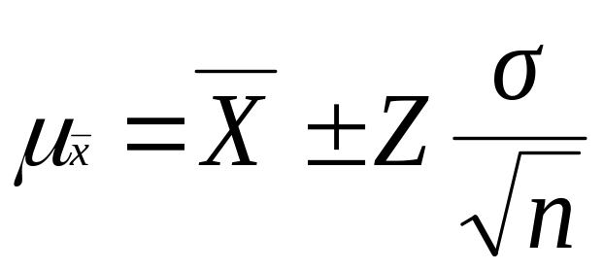
Confidence Interval Estimation of Population Mean, μ, when σ is known
Assumptions
  Population standard deviation σ is known
  Population is normally distributed
  If population is not normal, use large sample
Confidence interval estimate:
(where Z is the normal distribution’s critical value for a probability of α/2 in each tail)

Slide 6



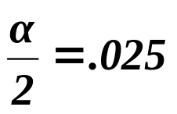
Consider a 95% confidence interval:
.475
.475
Z
Z= -1.96
0
Z= 1.96
Lower
Confidence
Limit
Upper
Confidence
Limit
Point Estimate
Point Estimate
μ
μ_{l}
μ_{u}

Slide 7

Example:
Suppose there are 69 U.S. and imported beer brands in the U.S. market. We have collected 2 different samples of 25 brands and gathered information about the price of a 6-pack, the calories, and the percent of alcohol content for each brand. Further, suppose that we know the population standard deviation ( ) of price is $1.45. Here are the samples’ information:
    Sample A: Mean=$5.20, Std.Dev.=$1.41=S
    Sample B: Mean=$5.59, Std.Dev.=$1.27=S
Perform 95% confidence interval estimates of population mean price using the two samples. (see the hand out).

Slide 8
Interpretation of the results from
  From sample “A”
    We are 95% confident that the true mean price is between $4.63 and $5.77.
    We are 99% confident that the true mean price is between $4.45 and $5.95.
  From sample “B”
    We are 95% confident that the true mean price is between $5.02 and $6.16. (Failed)
    We are 99% confident that the true mean price is between $4.84 and $6.36.
After the fact, I am informing you know that the population mean was $4.96. Which one of the results hold?
  Although the true mean may or may not be in this interval, 95% of intervals formed in this manner will contain the true mean.

Slide 9
Confidence Interval Estimation of Population Mean, μ, when σ is Unknown
If the population standard deviation σ is unknown, we can substitute the sample standard deviation, S
This introduces extra uncertainty, since S varies from sample to sample
So we use the student’s t distribution instead of the normal Z distribution

Slide 10
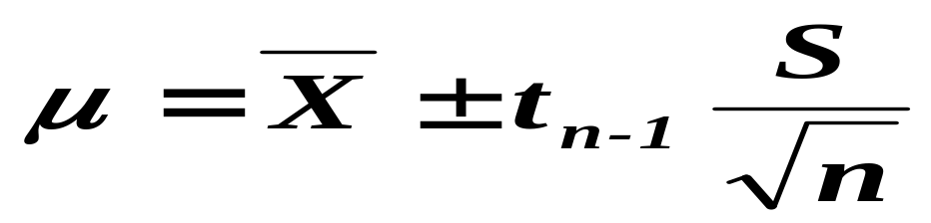
Confidence Interval Estimate Use Student’s t Distribution :
(where t is the critical value of the t distribution with n-1 d.f. and an area of α/2 in each tail)
t distribution is symmetrical around its mean of zero, like Z dist.
Compare to Z dist., a larger portion of the probability areas are in the tails.
As n increases, the t dist. approached the Z dist.
t values depends on the degree of freedom.

Slide 11
Student’s t distribution
Note: t Z as n increases
See our beer example
Standard Normal
t (df = 13)
t-distributions are bell-shaped and symmetric, but have ‘fatter’ tails than the normal
t (df = 5)
t
0

Slide 12
Determining Sample Size
The required sample size can be found to reach a desired margin of error (e) with a specified level of confidence (1 - α)
The margin of error is also called sampling error
  the amount of imprecision in the estimate of the population parameter
  the amount added and subtracted to the point estimate to form the confidence interval

Slide 13
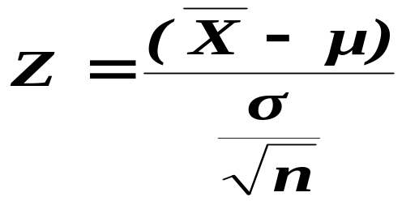
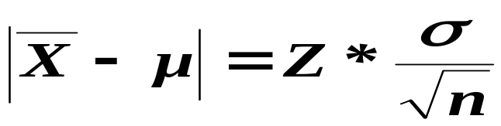
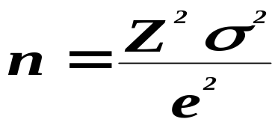
Using
_{Sampling Error, e}
To determine the required sample size for the mean, you must know:
1. The desired level of confidence (1 - α), which determines the critical Z value
2. The acceptable sampling error (margin of error), e
3. The standard deviation, σ

Slide 14
If unknown, σ can be estimated when using the required sample size formula
  Use a value for σ that is expected to be at least as large as the true σ
  Select a pilot sample and estimate σ with the sample standard deviation, S
Example: If σ = 20, what sample size is needed to estimate the mean within ± 4 margin of error with 95% confidence?

